Slide 1
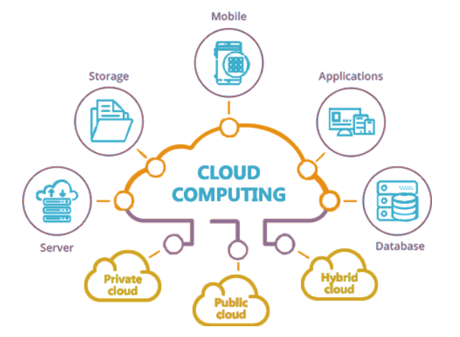
An Introduction to Cloud Computing
Atul Kahate

Slide 2
Section 1: Introduction to Cloud

Slide 3
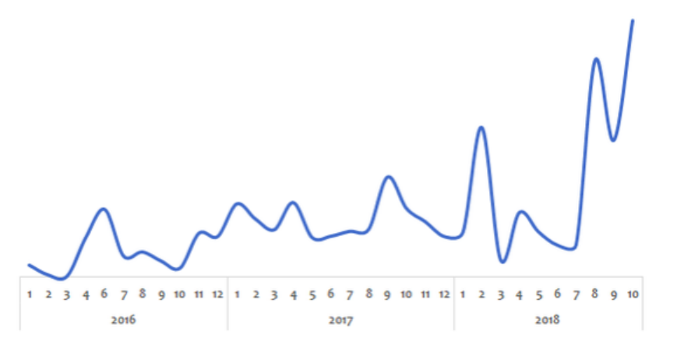
Why Cloud?
Peak loads vary (high during weekends and holidays)
Solution before Cloud: Peak Load Provisioning – Buy infrastructure for peak load – Wasted during less load

Slide 4
Challenges Before Cloud
High cost of infrastructure procurement
Need to plan ahead of time – Can we guess if a start up will be successful?
Low utilization of infrastructure due to peak load provisioning
Dedicated infrastructure team for maintenance

Slide 5
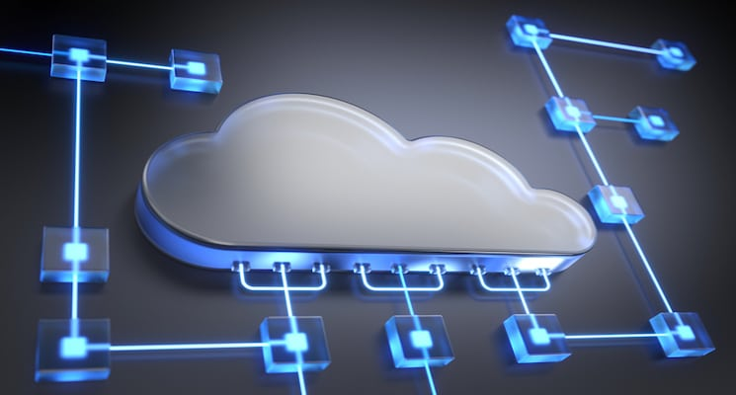
The Cloud Solution
Provision (i.e. rent) resources only when we need them, and release them when we do not need them
On demand resource provisioning
Hence called as elastic

Slide 6
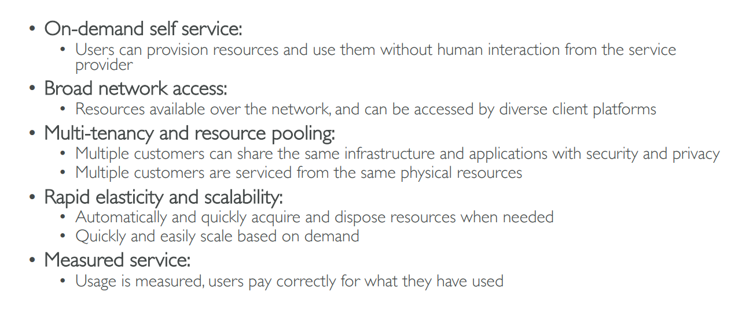
Five Characteristics of Cloud Computing

Slide 7
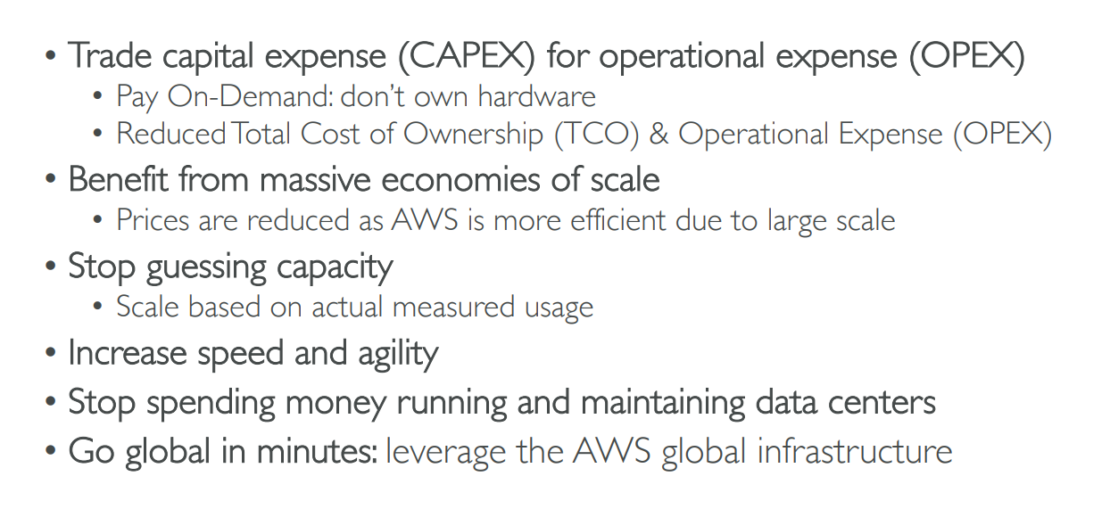
Six Advantages of Cloud Computing

Slide 8
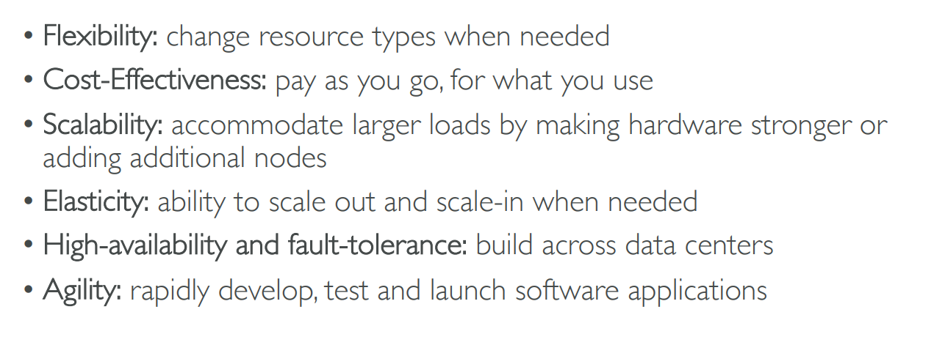
Problems solved by the Cloud

Slide 9
NIST Definition
Cloud Computing is a model for enabling convenient, on-demand network access to a shared pool of configurable computing resources (e.g., networks, servers, storage, applications, and services) that can be rapidly provisioned and released with minimal management effort or service provider interaction.

Slide 10
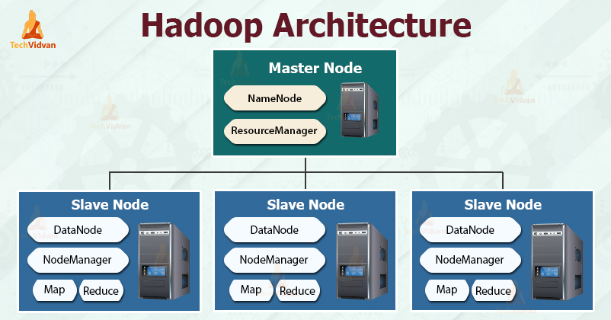
Grid Computing vs Cloud Computing
Grid computing consists of a large number of computers which are connected in parallel and forms a computer cluster. This combination of connected computers is used to solve a complex problem.
Example: Hadoop

Slide 11
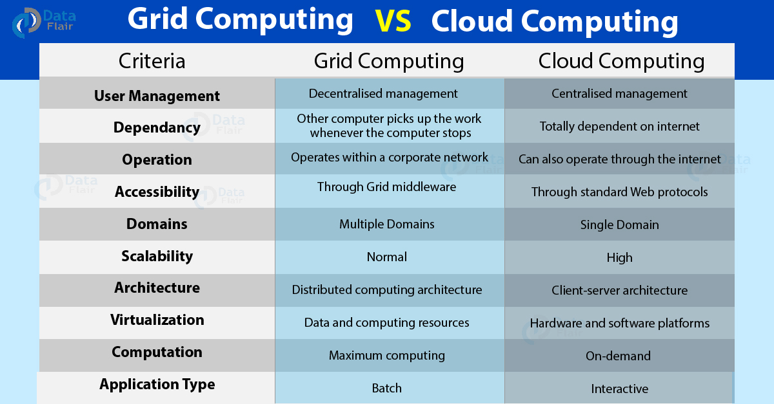
Grid Computing vs Cloud Computing

Slide 12
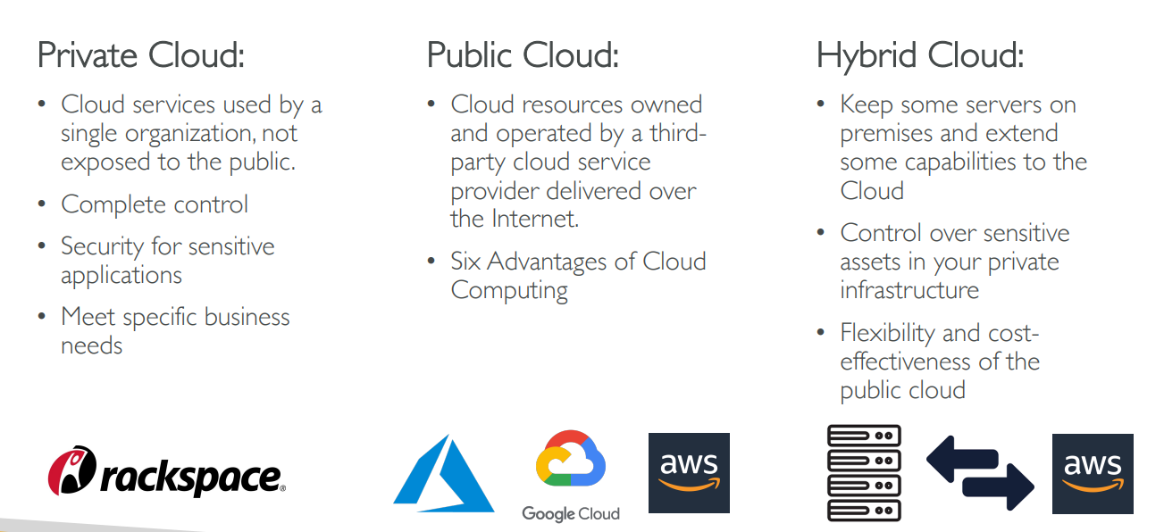
Cloud Deployment Models

Slide 13
Section 2: Managed Services/ Cloud Computing Types (SaaS, PaaS, IaaS, …)

Slide 14
Managed Services / Cloud Computing Types
Do you want to continue running applications in the cloud, the same way you run them in your data center?
OR are there OTHER approaches?
We should understand some terminology used with cloud services:
IaaS (Infrastructure as a Service)
PaaS (Platform as a Service)
SaaS (Software as a Service)
Sometimes also called as the SPI model (Saas, Paas, Iaas)
Let's understand these!

Slide 15
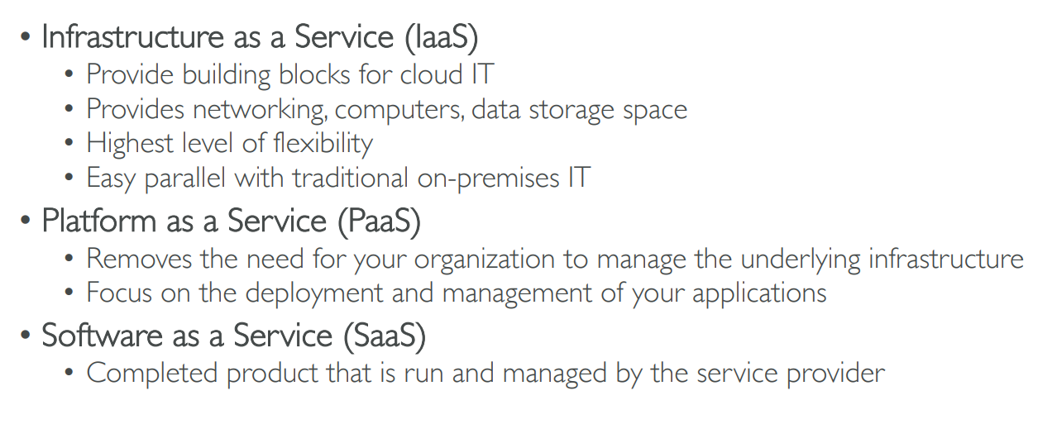
Iaas, Paas, SaaS

Slide 16
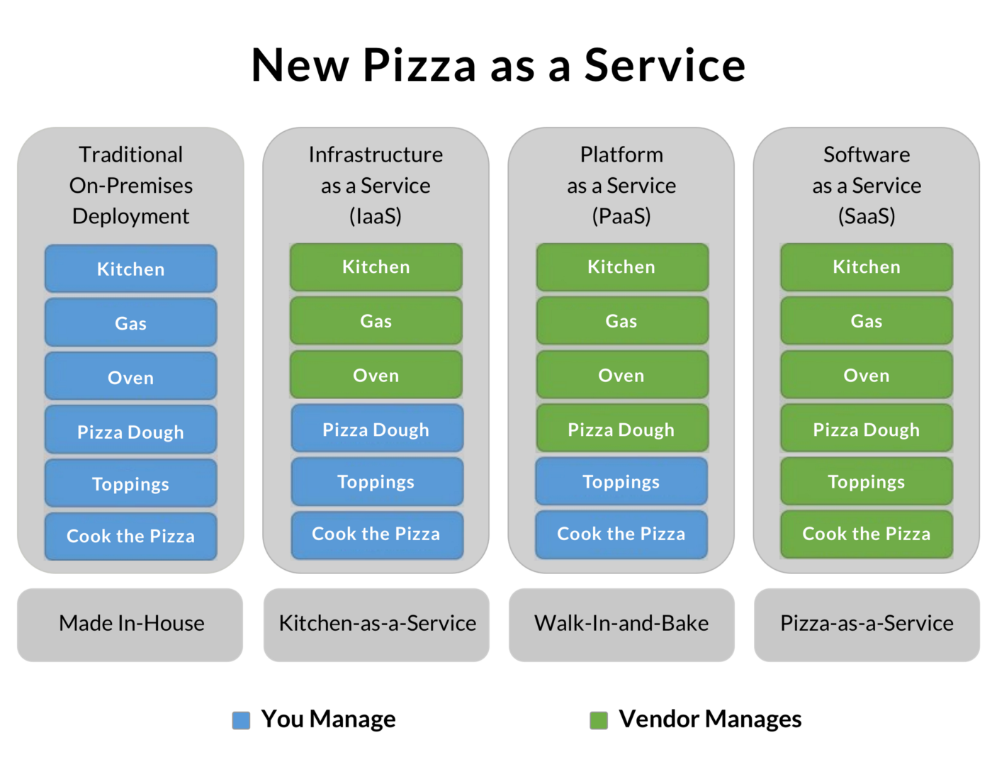
IaaS, PaaS, SaaS

Slide 17
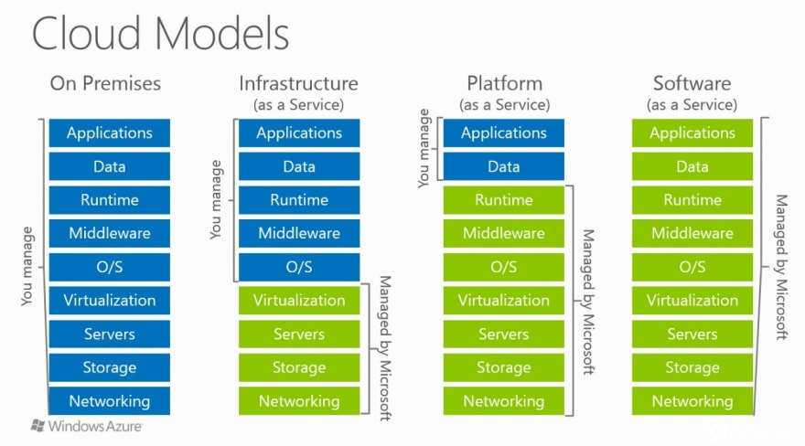
IaaS, PaaS, SaaS

Slide 18
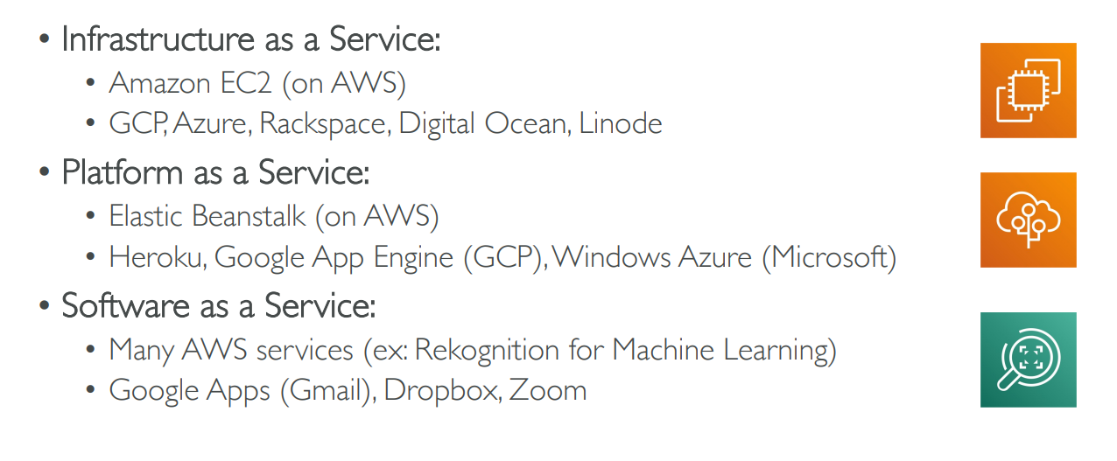
Example of Cloud Computing Types

Slide 19
Serverless Computing
What do we think about when we develop an application?
Where to deploy? What kind of server? What OS?
How do we take care of scaling and availability of the application?
What if you don't need to worry about servers and focus on your code?
Enter Serverless
Remember: Serverless does NOT mean "No Servers"
Serverless:
You don't worry about infrastructure (ZERO visibility into infrastructure)
Flexible scaling and automated high availability
Most Important: Pay for use
Ideally ZERO REQUESTS => ZERO COST
You focus on code and the cloud managed service takes care of all that is needed to scale your code to serve millions of requests!
And you pay for requests and NOT servers!

Slide 20
Deploying an Application on Cloud (AWS)
https://docs.aws.amazon.com/codedeploy/latest/userguide/welcome.html

Slide 21
Virtualization

Slide 22
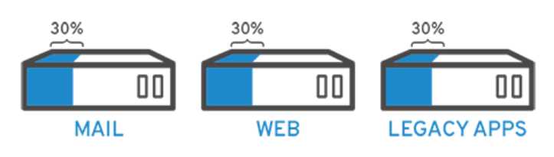
What is Virtualization?
Virtualization allows you to use a physical machine’s full capacity by distributing its capabilities among many users or environments
Example: Suppose we have three servers – 30% of capacity is used in each case
What can be done?

Slide 23
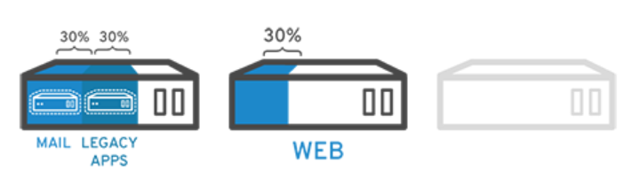
Solution: Virtualization
It does not stop here!
Keeping security in mind, you could split the first server again so it could handle another task—increasing its use from 30%, to 60%, to 90%. Once you do that, the now empty servers could be reused for other tasks or retired altogether to reduce cooling and maintenance costs.

Slide 24
How does Virtualization Work?
Virtualization is done using hypervisor
Hypervisor: A program that sits between the real (physical) machine and the virtual machine, enabling interaction between the two
Software called hypervisors separate the physical resources from the virtual environments—the things that need those resources
Hypervisors can sit on top of an operating system (like on a laptop) or be installed directly onto hardware (like a server), which is how most enterprises virtualize
Hypervisors take your physical resources and divide them up so that virtual environments can use them

Slide 25
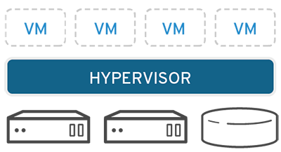
Resource Partitioning
Resources are partitioned as needed from the physical environment to the many virtual environments
Users interact with and run computations within the virtual environment (typically called a guest machine or virtual machine)
The virtual machine functions as a single data file
It can be moved from one computer to another, opened in either one, and be expected to work the same

Slide 26
Virtualization – Good References
https://www.ibm.com/cloud/learn/virtualization-a-complete-guide
https://www.stl.tech/blog/introduction-to-virtualization/

Slide 27
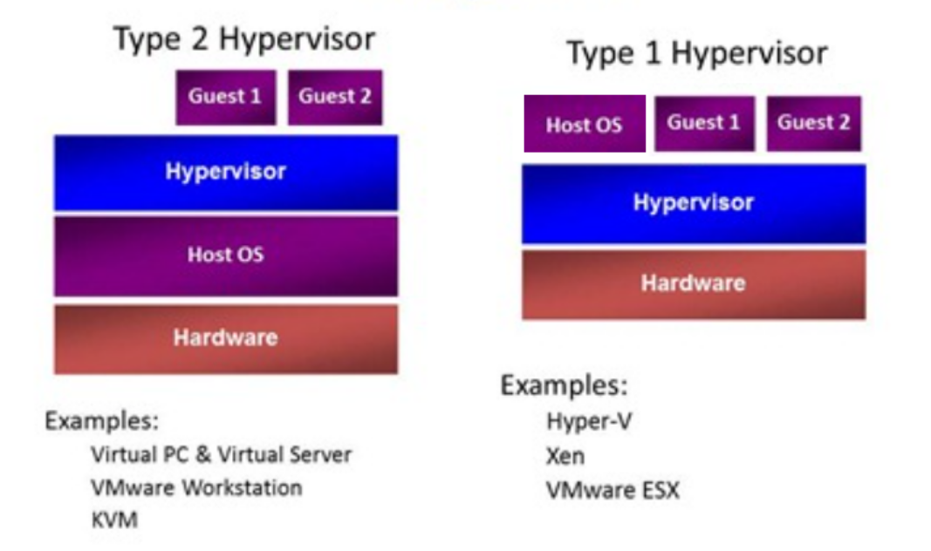
Virtualization Types

Slide 28
Type 1 and 2
Type 1 Hypervisors (Full Virtualization or Hardware Virtualization) sit between the hardware and your virtual machines AND your Host OS.
In effect, your Host OS is turned into a virtual machine as well. Each Guest OS has direct access to the native hardware via interface built into the Hypervisor.
Type 2 Hypervisors (Para Virtualization) sit between your virtual machines AND your Host OS.
The Guest OSs do not have direct access to Host hardware, and use emulated drivers.

Slide 29
Another important point
Type 1 Hypervisor is called a native or Bare Metal Hypervisor while type 2 Hypervisor is called a Host OS Hypervisor

Slide 30
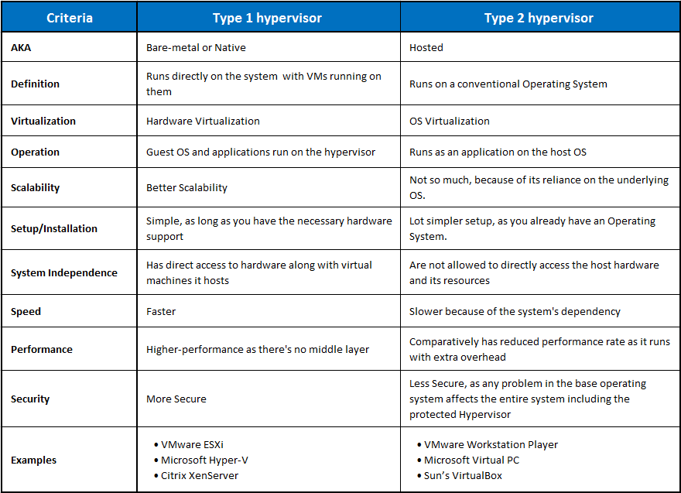

Slide 31
Multi-tenancy in Cloud
In cloud computing, multi-tenancy is all about sharing, i.e. multiple customers are served by a single instance of an application.
Sharing resources such as configurations, user management rules, and data – all of which can be customized and physically integrated but logically separated.
Types of multi-tenant cloud architectures

Slide 32
Types of Multi-tenant Cloud Architectures
One App Instance, One Database
A single instance of the software will support single databases.
This multi-tenancy architectural style offers scalability and increases capacity as and when the tenants increase.
However, the biggest drawback of one app instance, one database is the noisy-neighbour effect. (When multiple tenants make requests to the same database server, performance issues can occur resulting in noisy neighbours.)
One App Instance, Several Databases
A single instance of the software supports multiple databases. This can get expensive as you are asking for a separate space to store the tenant data.

Slide 33
Degrees of Multi-Tenancy
The degree of multi-tenancy is based on how much of the core application (SaaS) layer is designed to be shared across tenants.
The highest degree of multi-tenancy allows the database schema to be shared and supports customization of the business logic, workflow and user-interface layers.
In other words, all the sub-layers of SaaS offer multi-tenancy in this degree.
In the lowest degree, multi-tenancy is limited to the IaaS and PaaS layers, with dedicated SaaS layers for each tenant.
Examples
Salesforce.com, at the relatively high end of the multi-tenancy spectrum, has 72,500 customers who are supported by 8 to 12 multi-tenant instances (meaning IaaS/PaaS instances) in a 1:5000 ratio. So, each multi-tenant instance supports 5,000 tenants who share the same database schema.
Intacct, a financial systems SaaS provider has more than 2,500 customers who share 10 instances in a 1:250 ratio.

Slide 34
Multi-Tenancy Data Architecture
Four Approaches
Single database, shared schema
Single database, separate schema
Database per tenant
Multiple databases, multiple tenants per database, shared schema

Slide 35
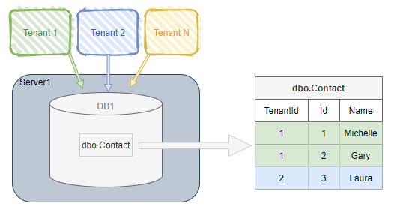
Single Database, Shared Schema
One database to hold the data for all tenants
Every tenant's data is stored in the same set of tables
Tables that contain tenant-specific data include a column to identify which tenant each row belongs to

Slide 36
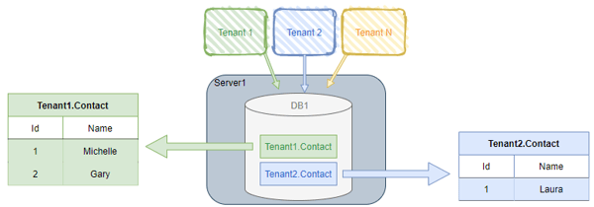
Single Database, Separate Schema
One database to hold the data for all tenants
Separate tables for each tenant, each set under a tenant-specific schema

Slide 37
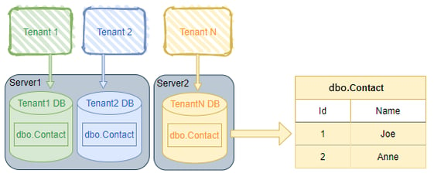
Database Per Tenant
Each tenant has its own database

Slide 38
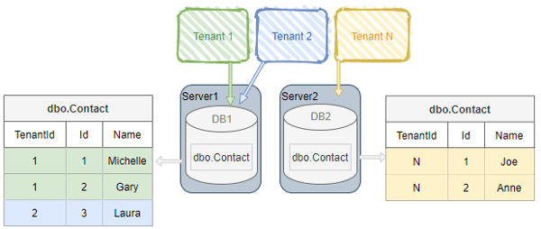
Multiple Databases, Multiple Tenants Per Database, Shared Schema
Hybrid of approach #1 and approach #3
A pool of databases exist
Tenants share a database and schema with other tenants, but are spread over multiple databases

Slide 39
How to Choose Multi-Tenancy Degree?
How much is the workload?
What is the type of application?
Example: Can a central vendor host an application for multiple clients that can share the same schema?
Security, Authorization

Slide 40
How to decide Level of Multi-tenancy?
https://docs.microsoft.com/en-us/azure/architecture/guide/multitenant/considerations/tenancy-models
https://cloud.google.com/kubernetes-engine/docs/best-practices/enterprise-multitenancy

Slide 41
Virtualization Provisioning
Virtual provisioning is a virtual storage network (VSAN)-based technology in which storage space is allocated on demand to devices.
This process allows virtualized environments to control the allocation and management of physical disk storage connected with virtual machines (VM).
Administrators typically allot storage space based on the anticipated growth of storage. This is because they want to minimize the management overhead and application downtime needed to add new storage afterwards. This results in the over-provisioning of the storage capacity which leads to greater costs, more power, cooling and floor space requirements and lower capacity utilization.
Virtual Provisioning addresses these challenges by giving more efficient utilization of storage by minimizing the amount of allotted, but unused physical storage.

Slide 42
LUN
A Logical Unit Number (LUN) is a unique identifier for designating an individual or collection of physical or virtual storage devices that execute input/output (I/O) commands with a host computer, as defined by the Small System Computer Interface (SCSI) standard.
SCSI is a widely implemented I/O interconnect that can facilitate data exchange between servers and storage devices.
LUN is like a block number on a disk

Slide 43
Thin Provisioning
With Thin Provisioning, the total overall user capacity is only allocated as virtual storage. Then actual physical disk capacity is allocated as and when it is needed. All physical disks are managed as a single disk pool and allocated according to the amount of data written to the virtual volumes. This reduces the amount of unused physical disk capacity and creates a much more effective storage operation. In addition, pre-defined thresholds avoid storage capacity shortages by warning when additional physical disks need to be added.
For example, a user requests 10TB of resource allocation from the server administrator.
While 10TB of physical storage capacity may eventually needed, current usage suggests 2TB of storage is sufficient. The system administrator therefore prepares 2TB of physical storage but allocates a 10TB virtual volume to the server. This means that the server can start using the existing physical disk pool which is only around 1/5 of the virtual volume. This 'start small' approach enables much more effective use of storage capacity.
As more physical capacity is required to support the virtual volume, existing physical volume capacity is consumed. In order to avoid a capacity shortage, the physical disk pool is monitored using a pre-defined usage threshold. For example, by defining 80% of the entire disk pool as the threshold, when that amount is reached, an alarm notifies the administrator to expand the number of physical disks. This means that the new drives can be added without stopping the system, ensuring continuous system operation.

Slide 44
Cloning
A VM clone is a copy of a virtual machine. The existing virtual machine is known as the parent, while the new VM is called the clone. After the cloning operation, the clone VM runs as a separate virtual machine.
Why would you need to clone a virtual machine? Cloning is a fast and simple way to create a new virtual machine that shares properties with an existing one. The process of installing a guest operating system and programs from scratch can take a great deal of time. Using cloning, you can perform installation and configuration once, and then use the clone as a basis for many future virtual machines.
VM cloning is most useful for deploying multiple identical virtual machines to a group of users. For example, a sysadmin can clone a virtual machine for each employee in a particular department—since the employees use the same applications, their setups should be the same. Similarly, a teacher may wish to clone a virtual machine for each student, with lesson materials and programs preinstalled. VM cloning is also helpful for software testing. Testers can clone a development environment and use it as a baseline for comparison while testing.

Slide 45
Snapshot
VMware snapshots are quick and easy way to save a state of a virtual machine (VM) before you test a patch, software update or other change. The VMware snapshot preserves the state and data of the VM at the current point in time, so when you are done testing, you can quickly revert the VM back to a desired state.
You can create a snapshot file with or without memory. A memory snapshot also captures the memory state of the VM and its power settings. If you create a snapshot without memory and revert to that snapshot, you will have to start the VM manually.

Slide 46
VM Template
A VM template is a master copy image of a virtual machine that includes VM disks, virtual devices, and settings.
A VM template can be used many times over for the purposes of VM cloning. You cannot power on and edit the template once it has been created.
This is by design, so that nobody can accidentally edit the virtual machine that is used as a template.
This approach provides greater security (and a more “foolproof” method) for VM cloning. After cloning the VM from a template, VM clones are not linked to a VM template and are independent.
If you want to edit a template, you should convert a template to a VM, edit the VM, and then convert the edited VM to a new template.

